Slide 1





Global Coffee Value Chain Sustainability
From farm to cup: risks, impacts, and actions to decarbonize, protect livelihoods, and meet rising consumer expectations

Slide 2


Origin Regions Map
Farm Economics (Cost/Yield)
Agenda
Climate Risk Hotspots
Processing & Logistics Flow (Sankey)
Certification Landscape
Retail Margin Waterfall
Our journey through the coffee value chain
Consumer Trendlines
LCA Results (Farm → Cup)
Interventions & ROI
Implementation Roadmap + Stakeholder Callouts

Slide 3
Origin Regions Map
Coffee production spans the 'Bean Belt' (25°N–25°S), with smallholders producing the majority of arabica.
Top Origin Countries
Brazil
~37%
Arabica-dominant
Vietnam
~17%
Robusta-dominant
Colombia
~8%
Arabica
Indonesia
~7%
Robusta/Arabica
Ethiopia
~4%
Arabica
Others
(50+ origins)
~27%
Mixed
Shares are indicative averages; actuals vary by harvest year.

Slide 4
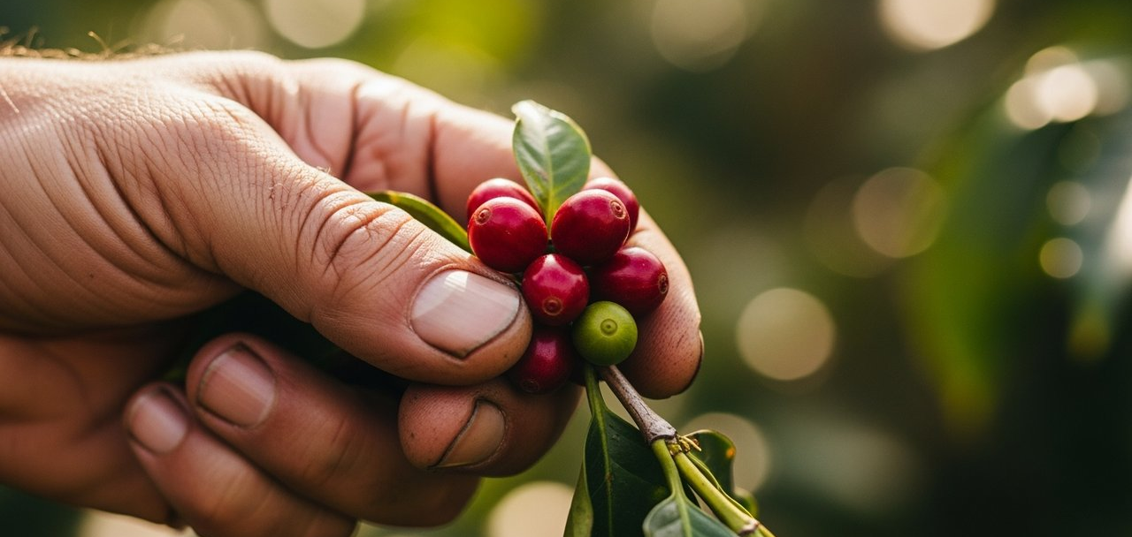

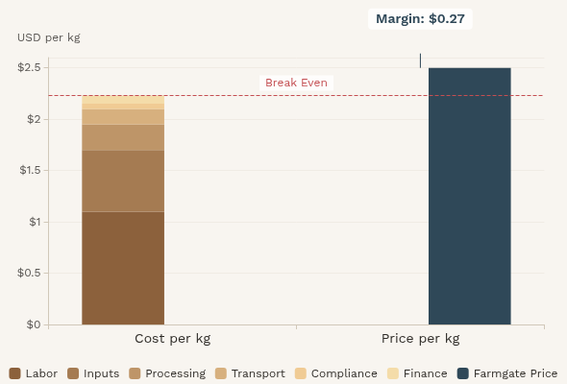

Farm Economics: Cost/Yield Breakdown
Illustrative per kg green coffee (USD, 2024) for a rainfed, mid-altitude arabica smallholder.
Smallholder arabica farmers operate with thin margins of $0.27 per kg (11% of farmgate price)
Key Yield Metrics
Trees per hectare
1,600
Green yield (kg/ha)
700
Annual revenue ($/ha)
$1,750
Annual cost ($/ha)
$1,561
Annual margin ($/ha)
$189
Margin per tree
$0.12
Values vary widely by altitude, farm size, input prices, and certification participation.

Slide 5



Climate Risk Hotspots
Rising temperatures and changing precipitation patterns threaten coffee suitability across the Bean Belt.
Risk Drivers
Rising temperatures shifting suitable altitude (~300 m per °C)
Rainfall variability and drought stress
Pest/disease pressure (coffee leaf rust, berry borer)
Central America (1,000–1,600 m)
High Risk
Rust resurgence, drought; suitability loss by 2050
Ethiopia highlands
Medium Risk
Suitability migration upslope; biodiversity trade-offs
Brazil (Minas Gerais)
High Risk
Heat waves, irregular rainfall; irrigation demand rising
Vietnam Central Highlands
Very High Risk
Water scarcity; robusta heat tolerance tested

Slide 6
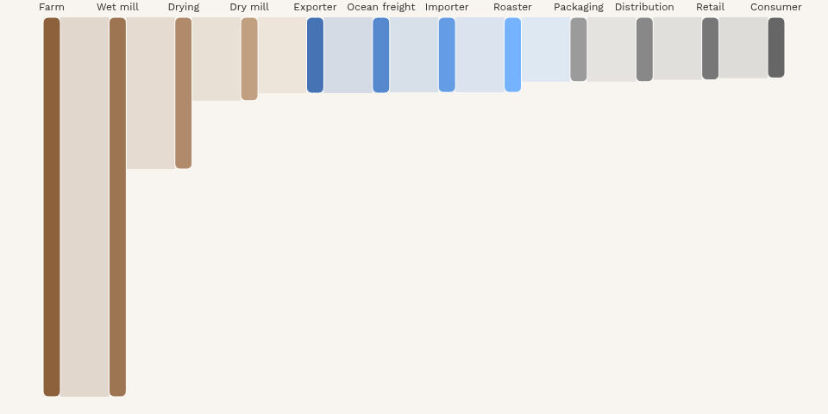




Processing & Logistics Flow (Sankey)
Mass flow baseline: From 100 units cherries → ~20 units green → ~17 units roasted → ~16 units sold. Showing transformation, yield loss, and key value chain handoffs.
Energy Hotspots
Roasting (thermal energy)
Brewing (consumer)
Ocean freight (if air freight avoided)
Key Loss Points
Wet mill: ~60% (cherry pulp)
Roasting: ~14% (moisture)
QC/Distribution: ~3% (quality rejects)
Farm/Processing
Logistics/Transport
Retail/Consumer
Percentages are illustrative; actuals vary by origin, processing method, and supply chain configuration.

Slide 7
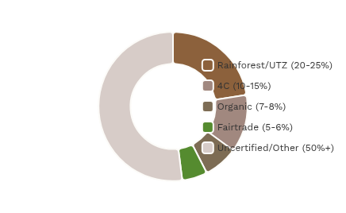
Certification Landscape
Various certification schemes with different focuses and requirements across the coffee value chain.
Certification Criteria Comparison
Scheme
Price/ Premium
Biodiversity
Social
Deforestation-free
Traceability
Price floor plus social premium
Basic environmental standards
Fairtrade
Fairtrade
Strong labor protections
Price floor + premium
Worker rights
Traceability: Batch/lot
Increasingly required
Deforestation free: Increasingly required
Rainforest Alliance (UTZ)
Batch/lot level traceability
Biodiversity
Climate-smart practices
Traceability: Mass balance or IP
Market-based premium
Deforestation free: Yes (criteria)
Organic
Extensive ecosystem criteria
No synthetic inputs
Traceability: Certified chain
Deforestation free: Implicit, not universal
Comprehensive social criteria
RA/UTZ
Schemes evolve; many buyers blend certifications with proprietary supplier requirements.
Strong deforestation criteria
Mass balance or identity preserved
Market-based premium only
Through input restrictions
Organic
Limited social criteria
Implicit but not universal
Full certified chain
No required premium
Basic requirements only
4C
Basic social standards
Baseline checks
Mass balance approach
Quality-based premiums common
Varies by buyer policy
Direct Trade
Relationship-focused
Buyer policy dependent
Often strong, non-standardized

Slide 8
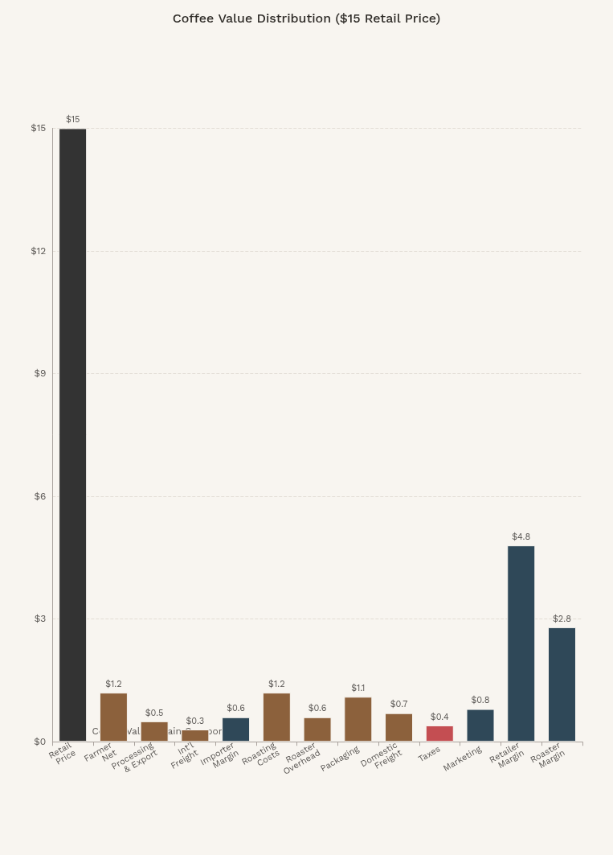

Retail Margin Waterfall
Example breakdown of a $15 retail price for a 12-oz bag of specialty coffee.
Price Components
Supply Chain Costs
Farmer net (farmgate)
$1.20
Local processing/export fees
$0.50
International freight/insurance
$0.30
Roasting energy/labor
$1.20
Roaster overhead/depreciation
$0.60
Packaging & labels
$1.10
Domestic freight/warehousing
$0.70
Duties & Taxes
Duties/taxes
$0.40
Margins
Importer margin/finance
$0.60
Brand/marketing
$0.80
Retailer margin
$4.80
Roaster net margin
$2.80
Retail Price
$15.00
Farmgate share of retail price: ~8%
Illustrative; varies by channel (DTC vs grocery), volume, and origin.
Supply Chain Costs
Margins
Taxes

Slide 9
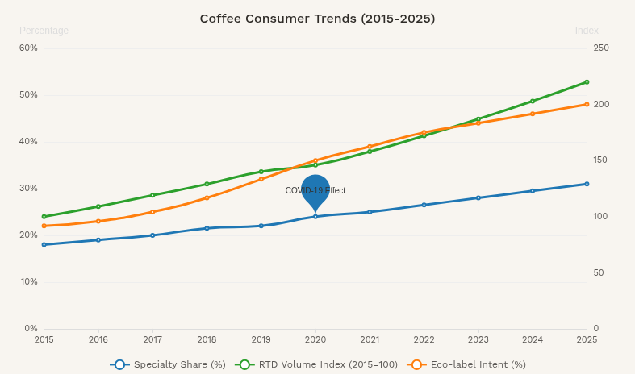





Consumer Trendlines
Coffee consumption patterns show shifting preferences toward specialty offerings, ready-to-drink formats, and eco-conscious choices.
Key Market Trends
Specialty coffee share rising +2–3 percentage points over 5 years
Ready-to-Drink (RTD) category growing at ~8–10% CAGR globally
Eco-label purchase intent increased ~+12 percentage points since 2018
At-home brewing upgrades post-2020; higher grinder/espresso machine penetration
Plant-based milks in coffee showing double-digit growth; sustainability often cited
Price Sensitivity Note: At-home demand elasticity ≈ -0.6; out-of-home ≈ -1.1 (indicative)

Slide 10
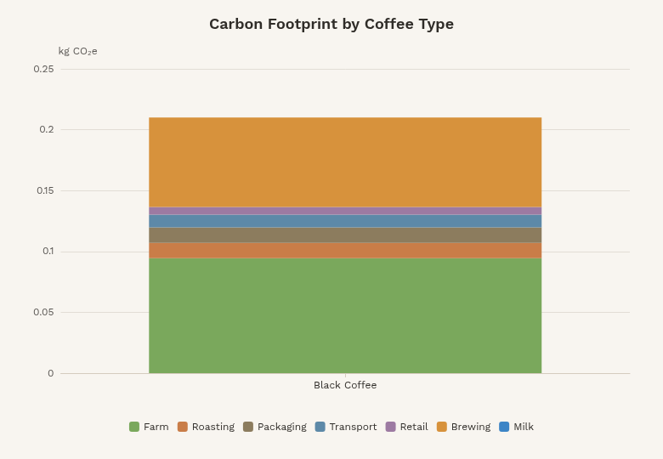







Life Cycle Assessment (LCA): From Farm to Cup
Analysis of greenhouse gas emissions and environmental impact across the coffee value chain
GHG Intensity by Coffee Type
Black Coffee
≈0.21 kg CO
e
2
With 30ml Milk
≈0.34 kg CO
e
2
Latte (200ml Milk)
≈0.90 kg CO
e
2
Functional Unit & System Boundary
One 250 ml cup of black coffee. Analysis covers farm inputs, processing, transport, roasting, packaging, retail, brewing, and end-of-life.
Black Coffee Breakdown
Farm/Inputs/Land
45%
Roasting
6%
Packaging
6%
Transport
5%
Retail/Last-mile
3%
Consumer Brewing
35%
Black Coffee
With 30ml Milk
Latte
Water footprint: Large green water (rain) component; blue water hotspots in irrigated regions (e.g., Brazil, Vietnam).
Farm
Roast
Pack
Transport
Retail
Brew
Milk

Slide 11
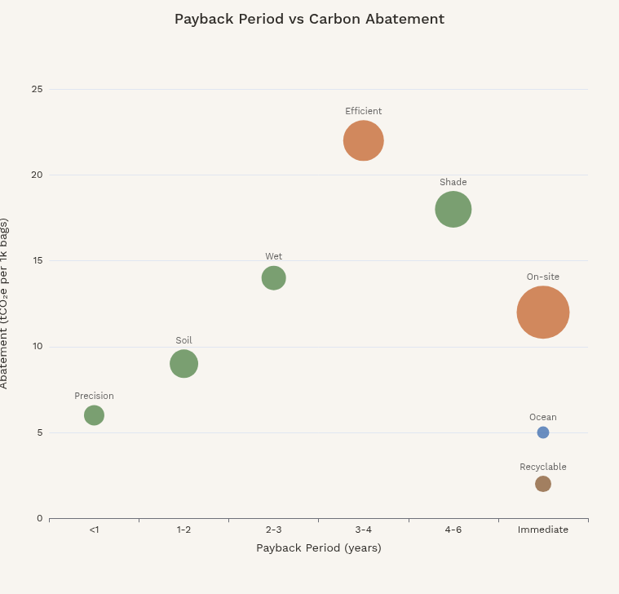

Interventions and ROI
Analyzing sustainability initiatives across the coffee value chain by payback period, carbon abatement potential, and investment requirements.
Key Initiatives
Shade Agroforestry (Farm)
Capex:
$350/ha
Payback:
3-4 yrs
NPV 5Y:
Positive
Abatement:
18 tCO₂e/1k bags
Heat resilience
Biodiversity
Quality
Soil Health (Compost/Mulch)
Capex:
$120/ha/yr
Payback:
1-2 yrs
NPV 5Y:
Positive
Abatement:
9 tCO₂e/1k bags
Yield +8%
Water retention
Precision Fertilization/IPM
Capex:
$50/ha (training)
Payback:
<1 yr
NPV 5Y:
Positive
Abatement:
6 tCO₂e/1k bags
Input savings ~15%
Value Chain Stage:
Bubble Size:
Wet Mill Water Recycle + Biogas
Farm
Logistics
Indicative economics; verify locally. Many farm practices are 'no-regrets' with yield and quality gains.
Roasting
Packaging
Capex:
$7k/co-op
Payback:
2-3 yrs
NPV 5Y:
Positive
Abatement:
14 tCO₂e/1k bags
Fuel switch from LPG
Effluent control
Efficient Roasters + Heat Recovery
Capex:
$70k/plant
Payback:
≈3 yrs
NPV 5Y:
Positive
Abatement:
22 tCO₂e/1k bags
Quality consistency
On-site Solar (Roastery)
Capex:
$150k
Payback:
4-6 yrs
NPV 5Y:
Mixed
Abatement:
12 tCO₂e/1k bags
Energy cost hedge
Lightweight, Recyclable Packs
Capex:
+$0.05/bag
Payback:
Immediate (freight)
NPV 5Y:
Positive
Abatement:
2 tCO₂e/1k bags
Lower material use
Ocean Freight Optimization
Capex:
N/A (policy)
Payback:
Immediate
NPV 5Y:
Positive
Abatement:
5 tCO₂e/1k bags
Lower cost via slow steaming

Slide 12
Implementation Roadmap + Stakeholder Callouts
Phased approach with clear stakeholder actions to achieve sustainability goals across the value chain
0-6 months
6-18 months
18-36 months
Pilots complete
Scale phase
Program maturity
Traceability & Compliance
Farming & Resilience
Sustainability + Procurement
Roasting & Energy
% lots traceable
Ops/Engineering
Deforestation risk cleared
kWh/kg roasted
Scope 1–2 emissions
Logistics & Packaging
Consumer & Brand
Stakeholder Callouts
Farmers/Co-ops
Exporters/Importers
Roasters
Retailers
Adopt shade/soil/IPM; share plot data for MRV; receive premiums/inputs.
Provide traceability docs; offer pre-finance; segregate lots.
Invest in efficiency; shift to renewables; publish specs to suppliers.
Commit to shelf standards; co-fund certifications; transparent pricing.
Certifiers/NGOs
Financiers/DFIs
Governments
Streamline audits; align metrics; support training.
Offer concessional credit and risk-sharing for smallholders.
Land-use enforcement; climate-smart extension; water stewardship.

